Slide 1


NATURE’S FRESH MART
TEAM NAME : GROUP 7
PROJECT MANAGER: ROHIT RAJ PANDEY
SPONSORED BY : THE BRITISH COLLEGE

Slide 2

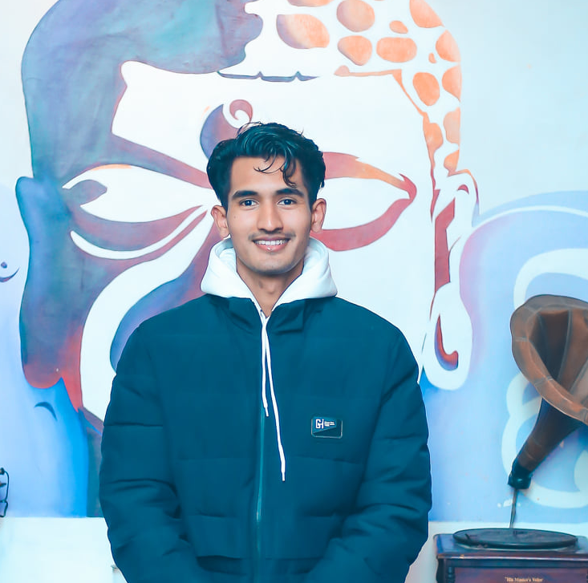


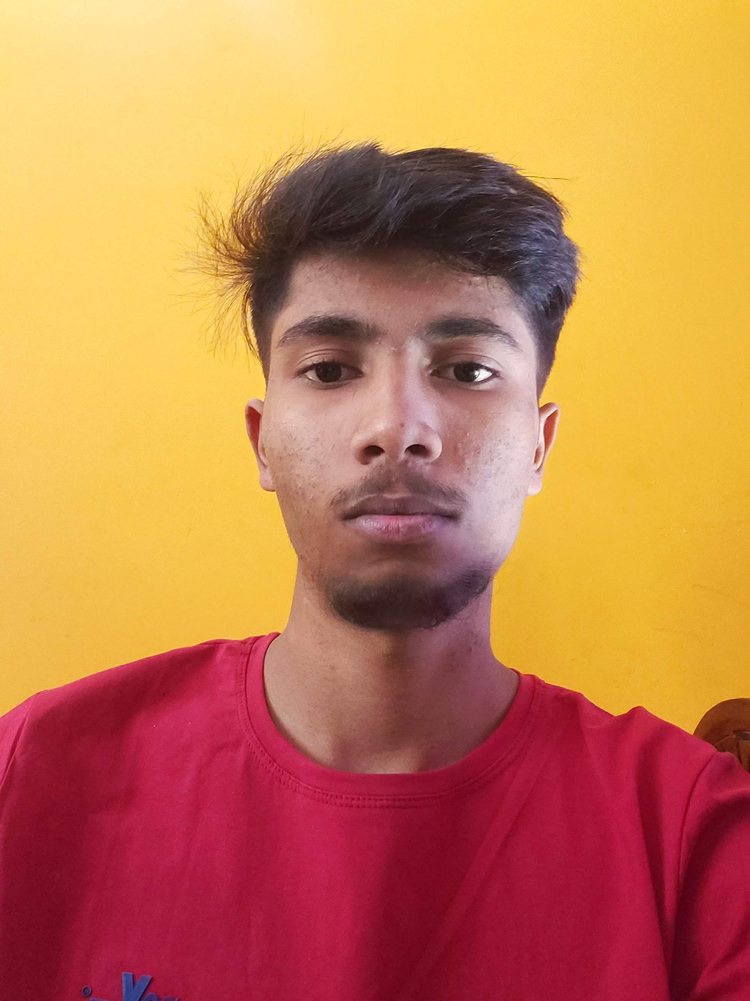
TEAM PRESENTATION
Saugat Thapa
Co-Ordinator
Plant
Shaper
Rajesh Basnet
Specialist
Complete Finisher
Resource Investigator
Gaurav Bhansali
Shaper
Team Worker
Plant
Harsh Gupta
Team Worker
Monitor Evaluator
Complete Finisher
Aakash Das
Specialist
Complete Finisher
Resource Investigator

Slide 3
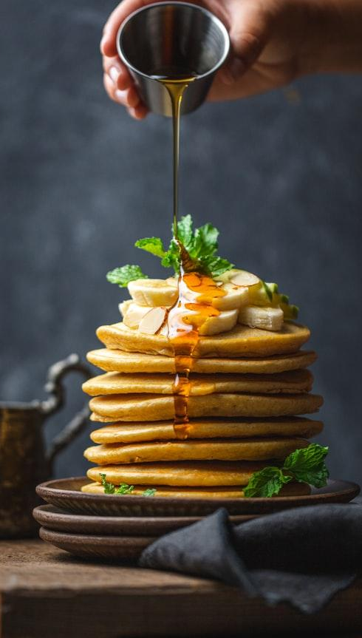
CONTENTS
Project Charter
Belbin Analysis
ERD
EERD
Final Composite EERD
Use Cases
MS-PROJECT
Website Demonstration

Slide 4
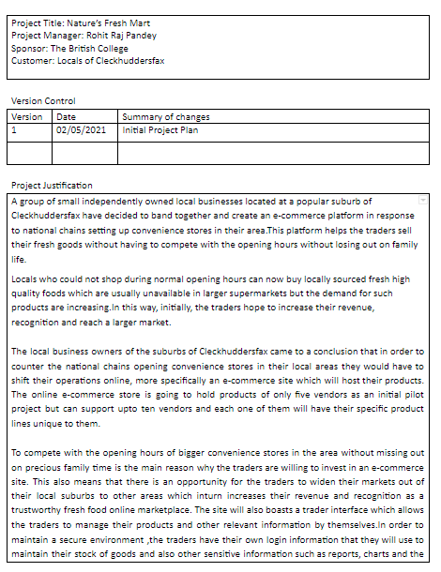
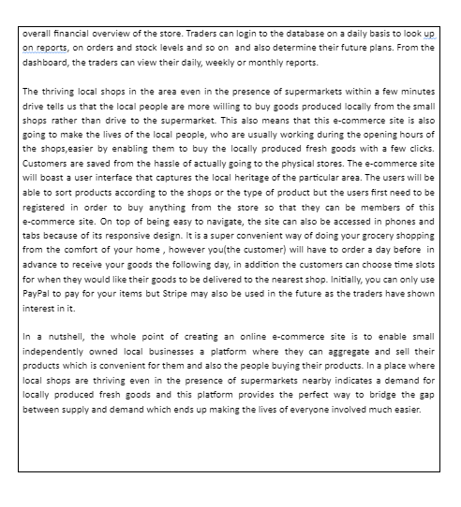
PROJECT CHARTER

Slide 5
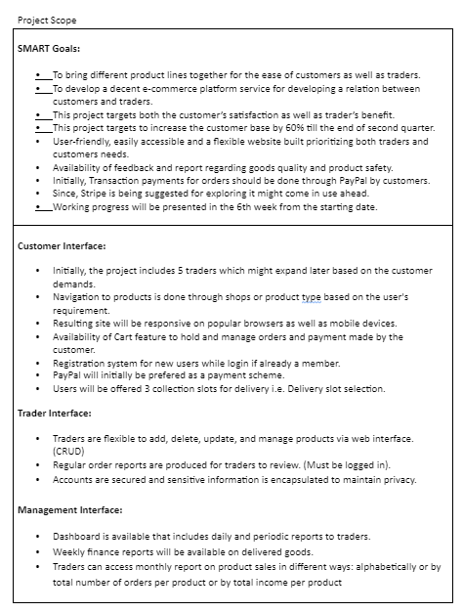
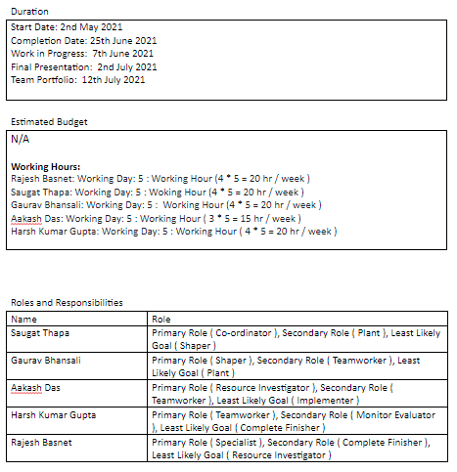
PROJECT CHARTER

Slide 6
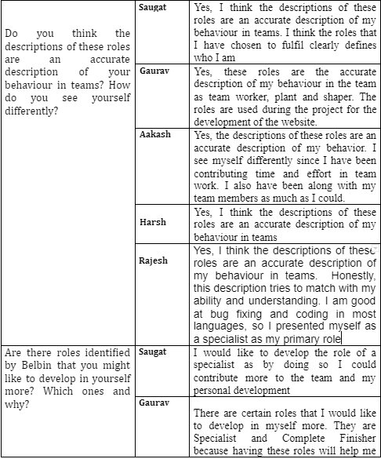
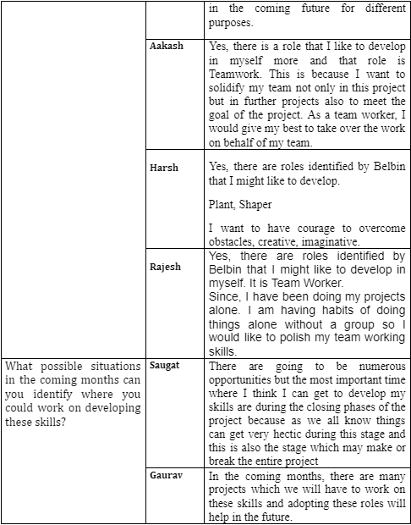
BELBIN ANALYSIS

Slide 7
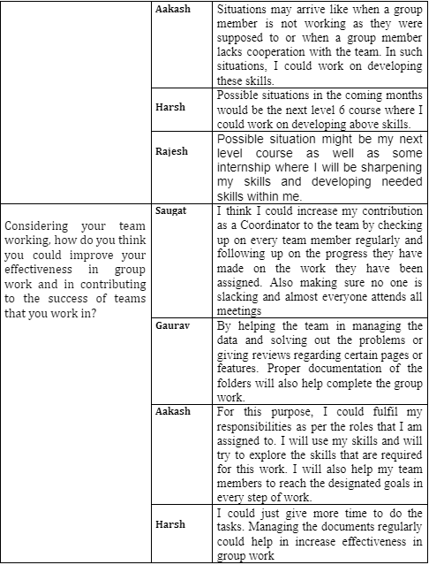
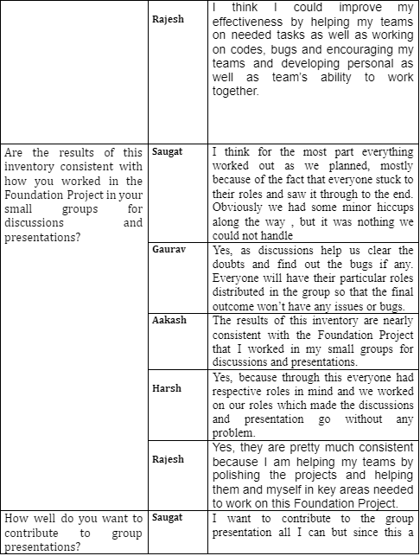
BELBIN ANALYSIS

Slide 8
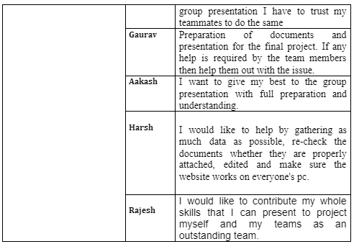
BELBIN ANALYSIS

Slide 9
ENTITY RELATIONSHIP DIAGRAM

Slide 10
EXTENDED-ENTITY RELATIONSHIP DIAGRAM

Slide 11
COMPOSITE-EXTENDED ERD

Slide 12
OVERALL USE-CASE DIAGRAM

Slide 13
CUSTOMER USE-CASE DIAGRAM

Slide 14
TRADER USE-CASE DIAGRAM

Slide 15
ADMIN USE-CASE DIAGRAM

Slide 16
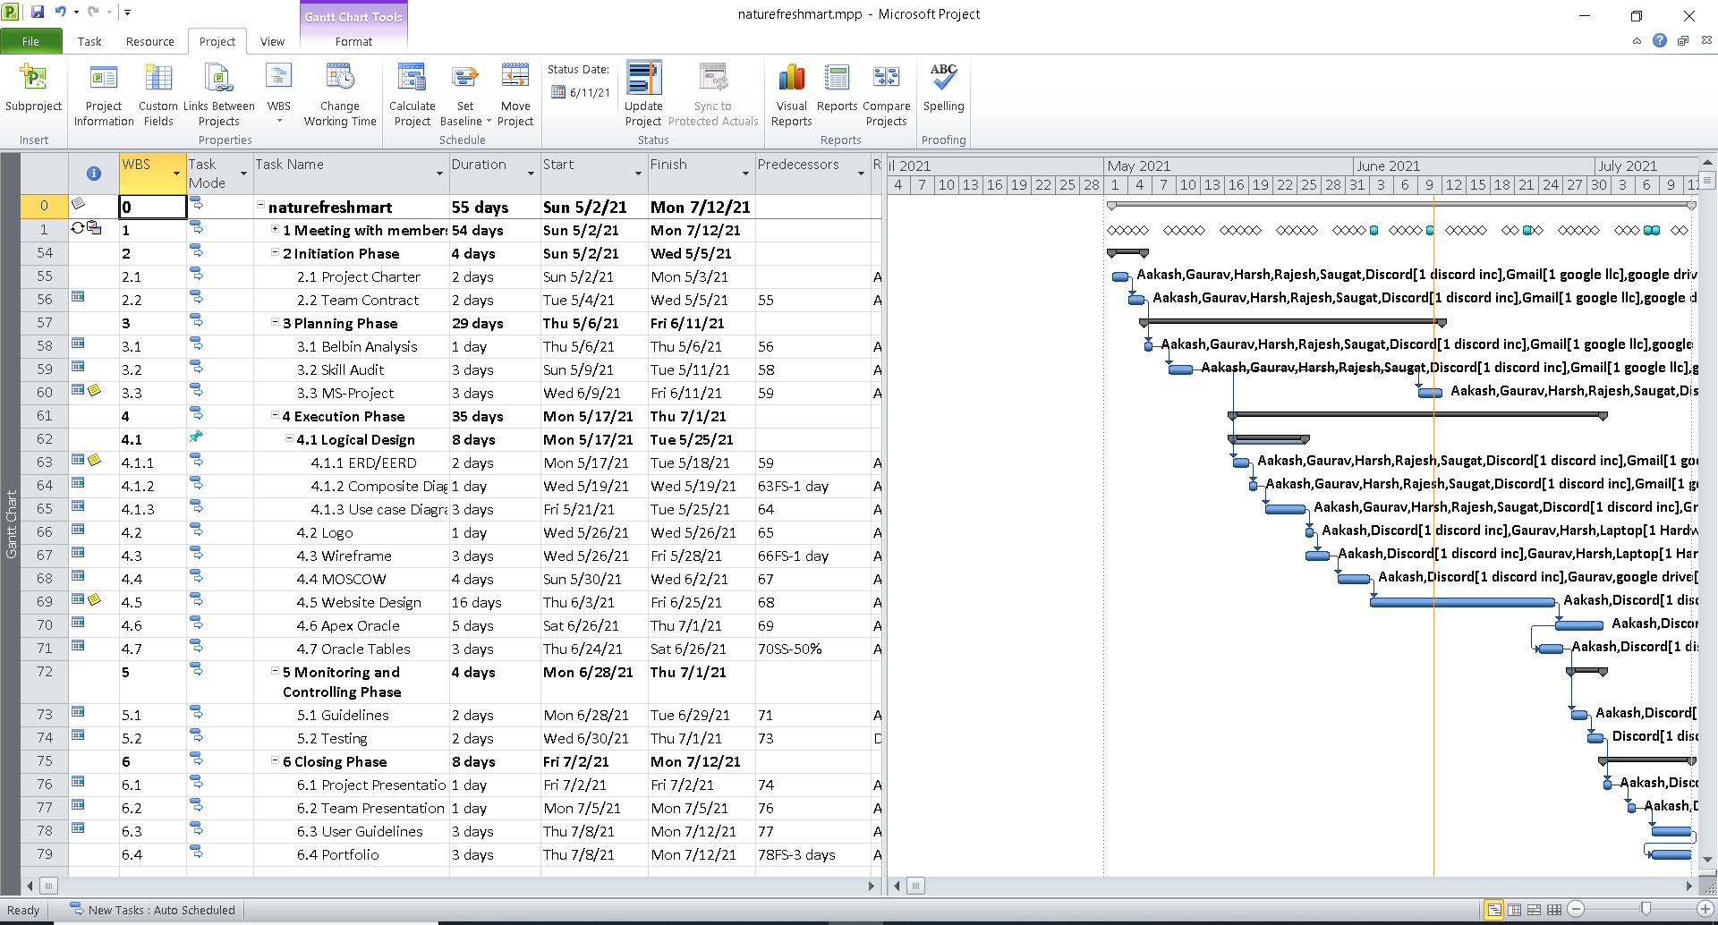
GANTT CHART

Slide 17
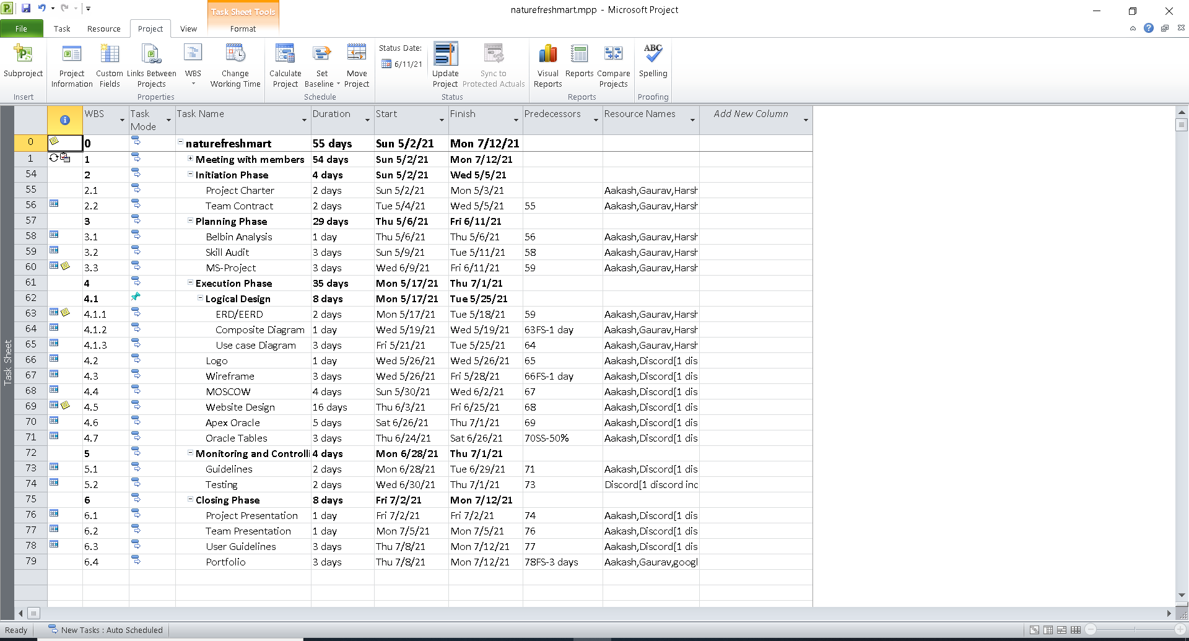
TASK SHEET

Slide 18
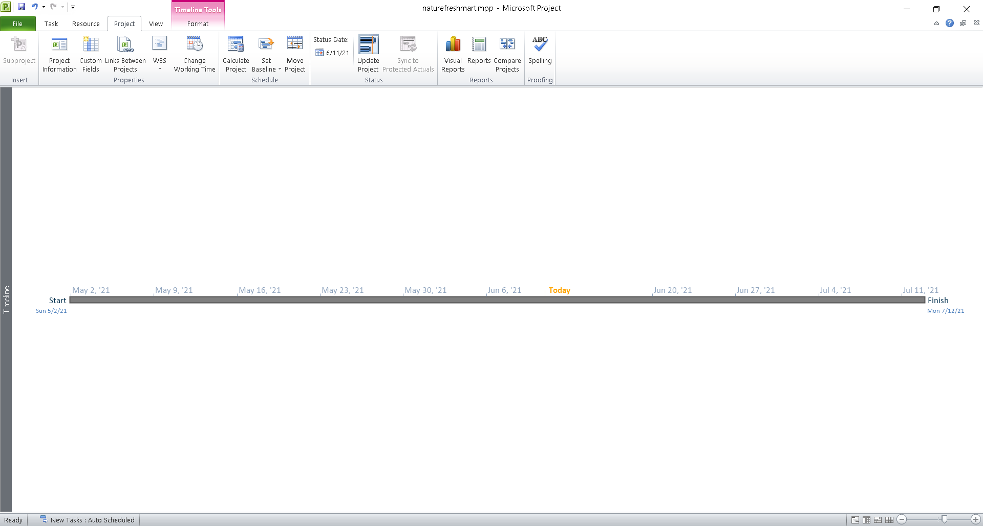
TIMELINE

Slide 19
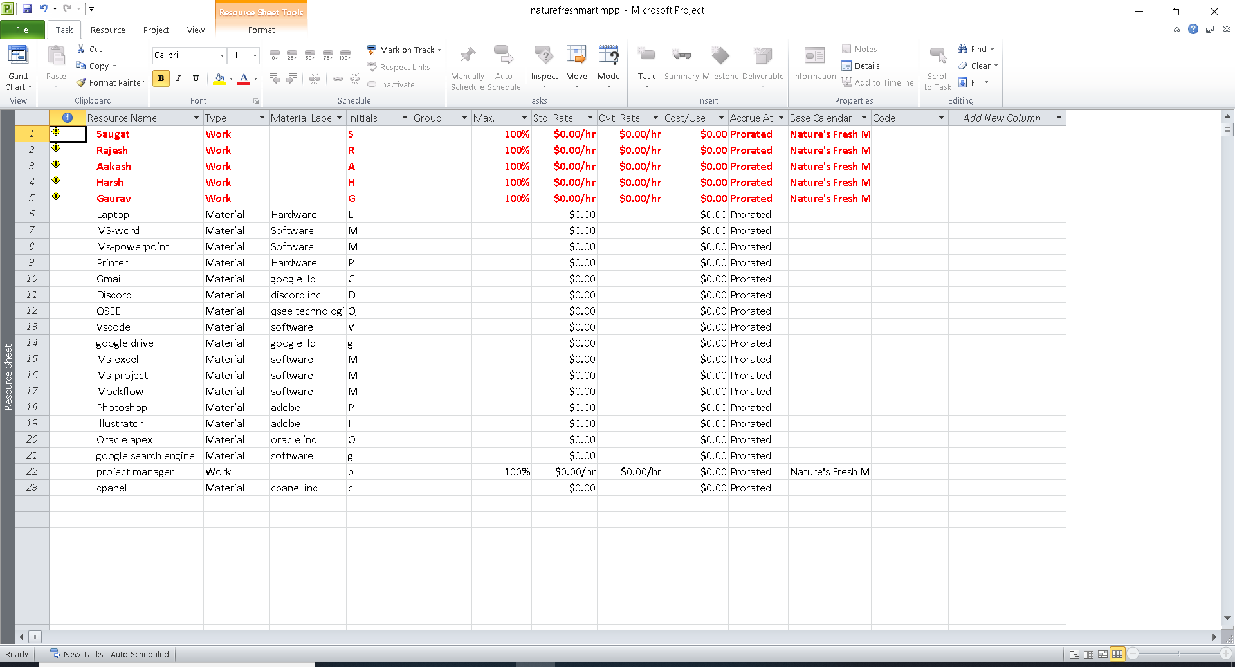
RESOURCE SHEET

Slide 20
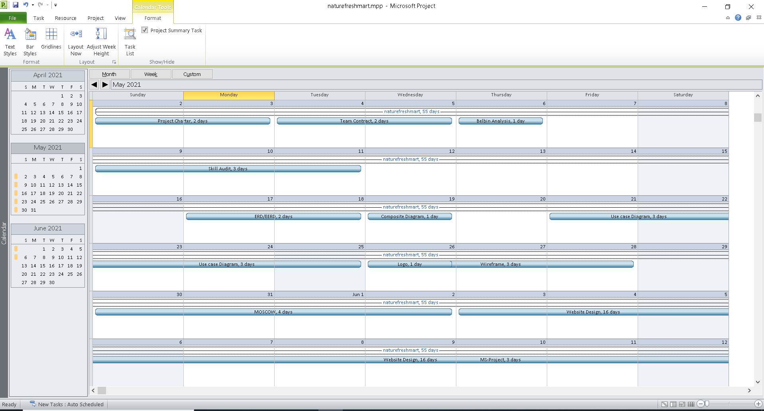
CALENDER

Slide 21
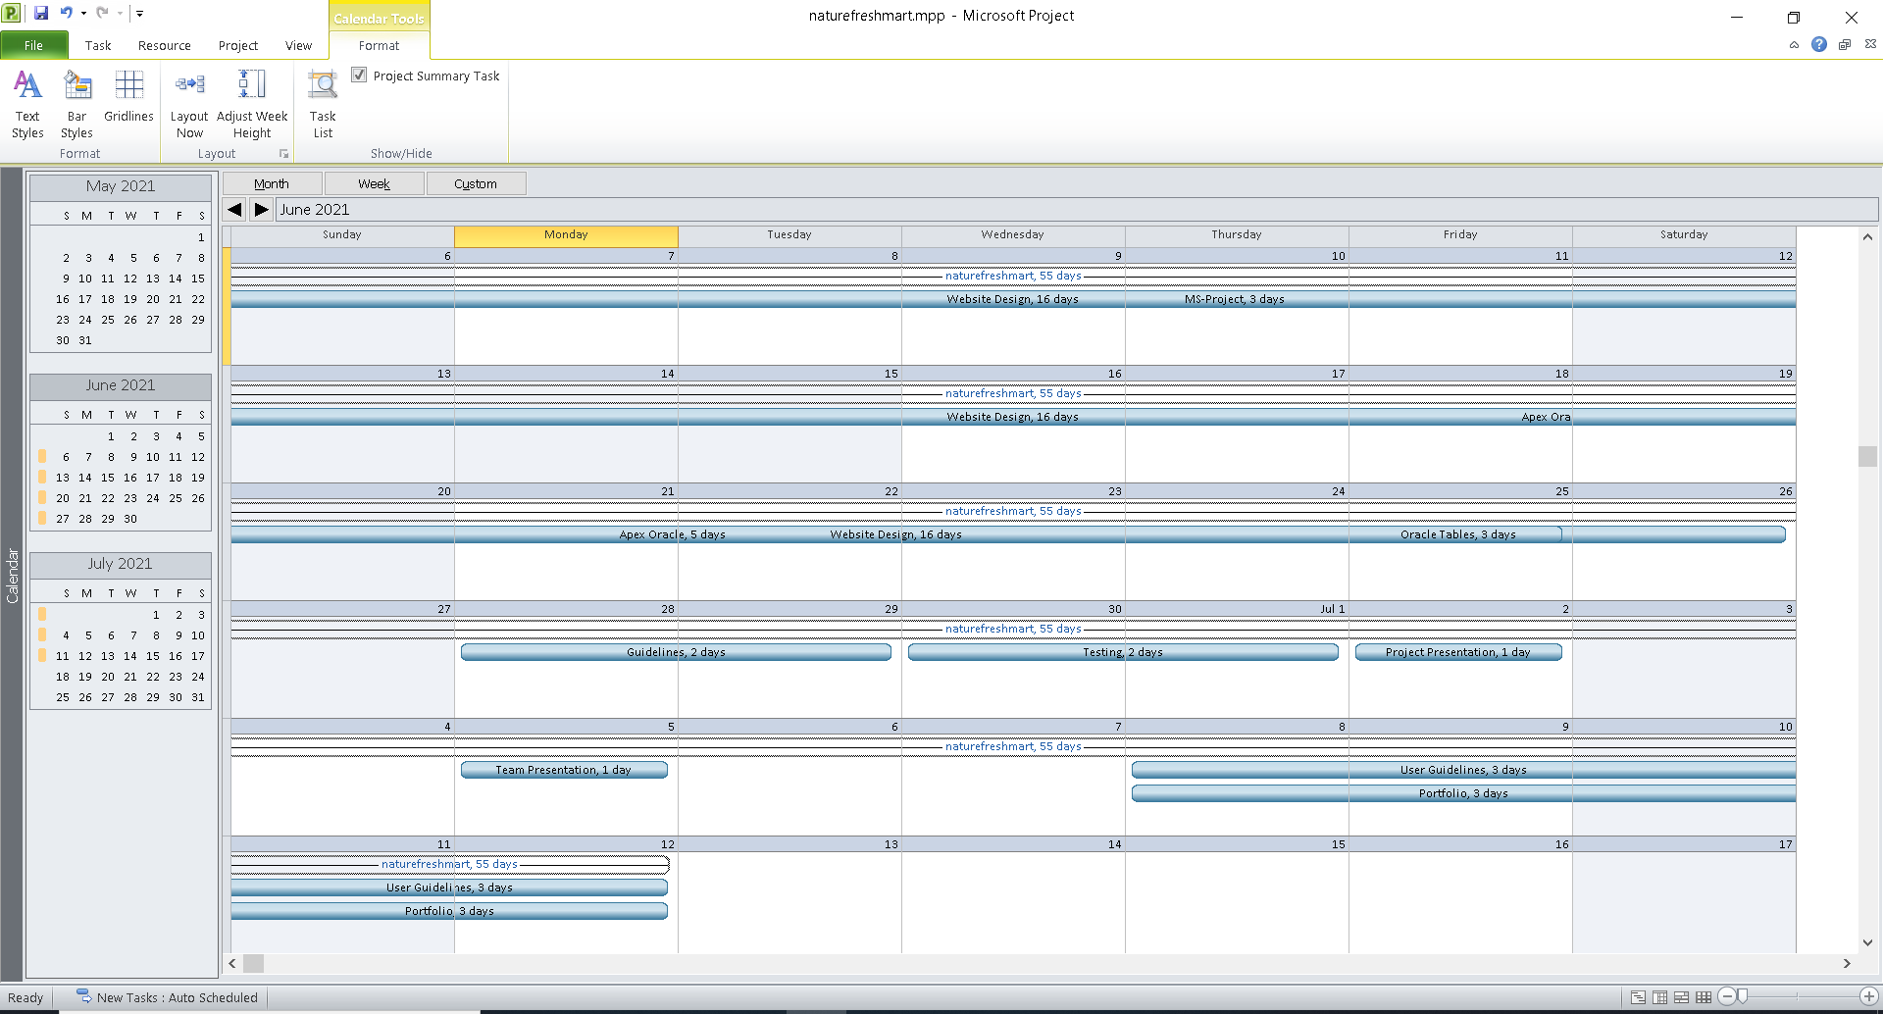
CALENDER

Slide 22
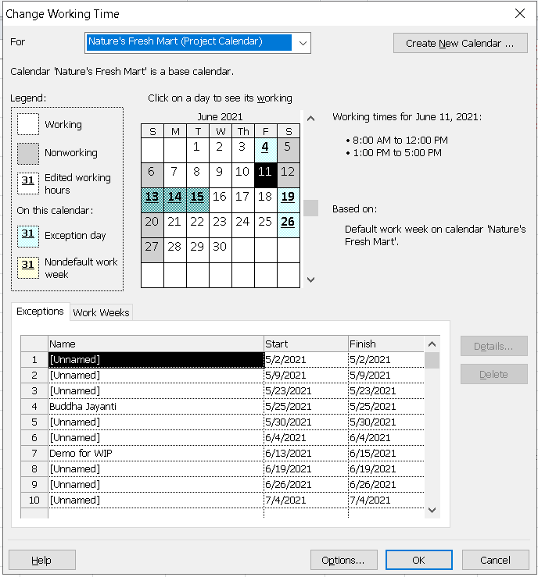
CHANGE IN WORKING TIME

Slide 23
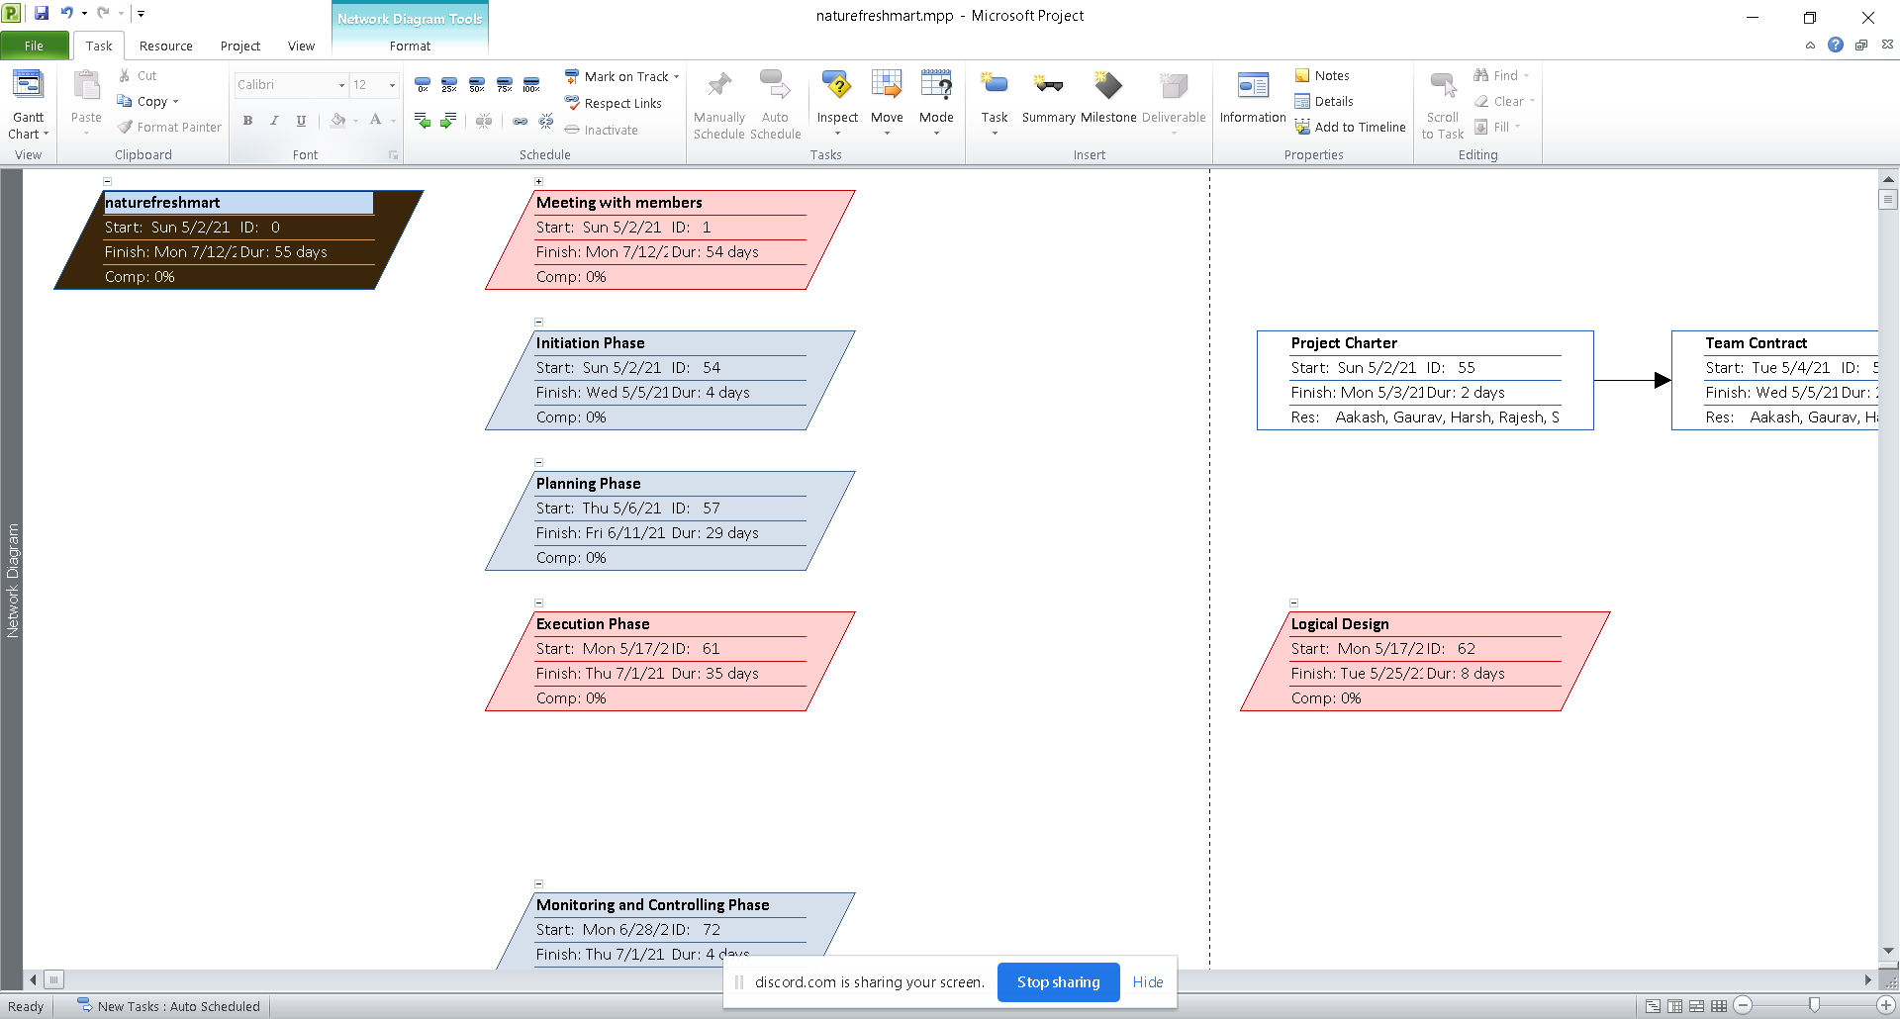
NETWORK DIAGRAM

Slide 24
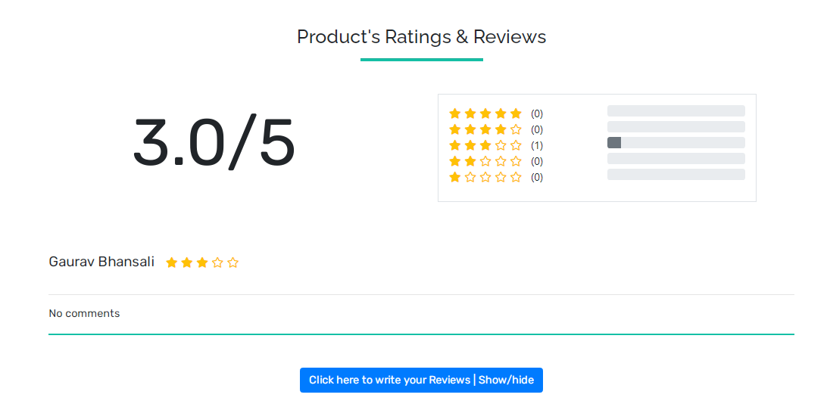
ADDITIONAL FEATURE (AVERAGE RATING)

Slide 25
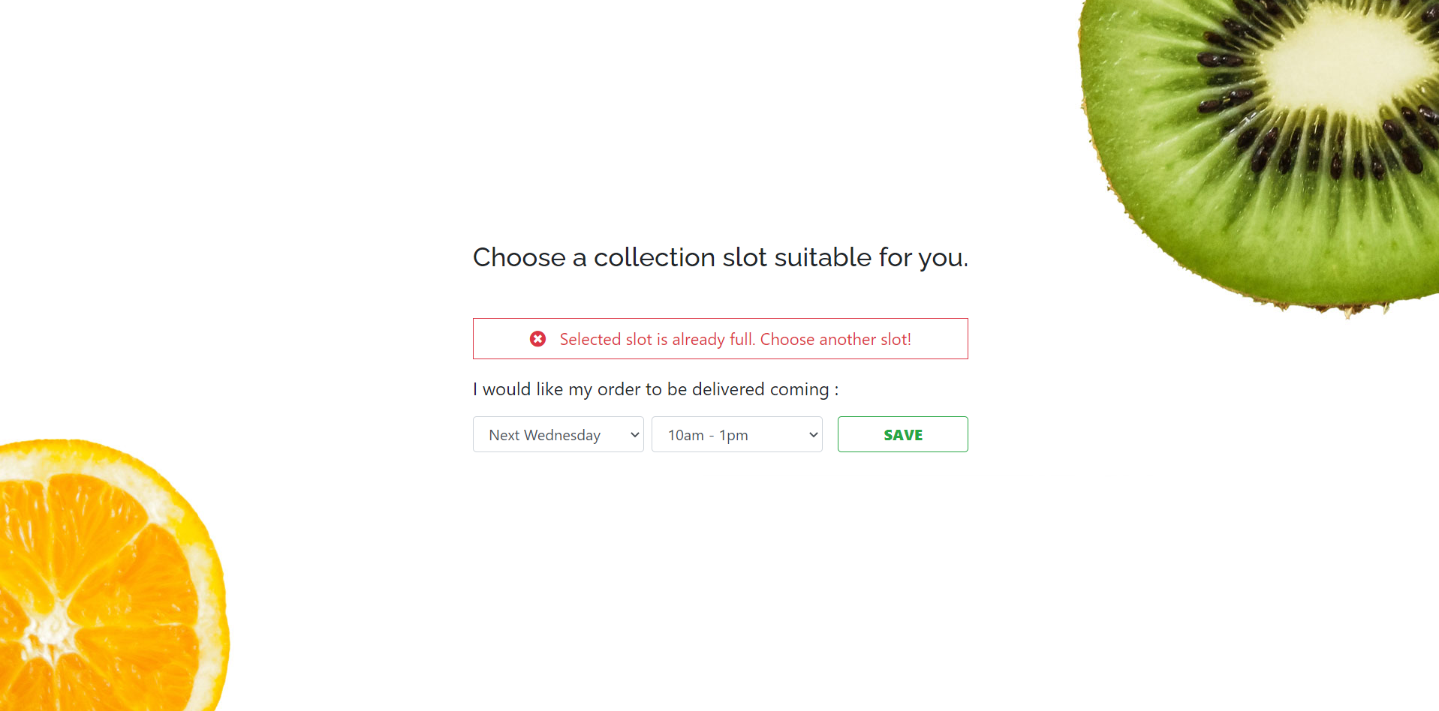
ADDITIONAL FEATURE (COLLECTION SLOTS)

Slide 26
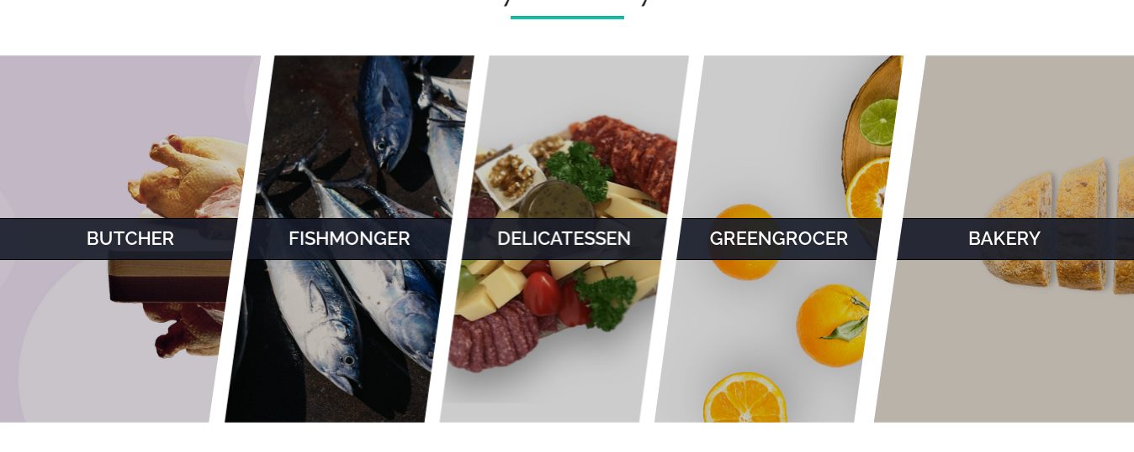
ADDITIONAL FEATURE (AVENGER STYLE)

Slide 27
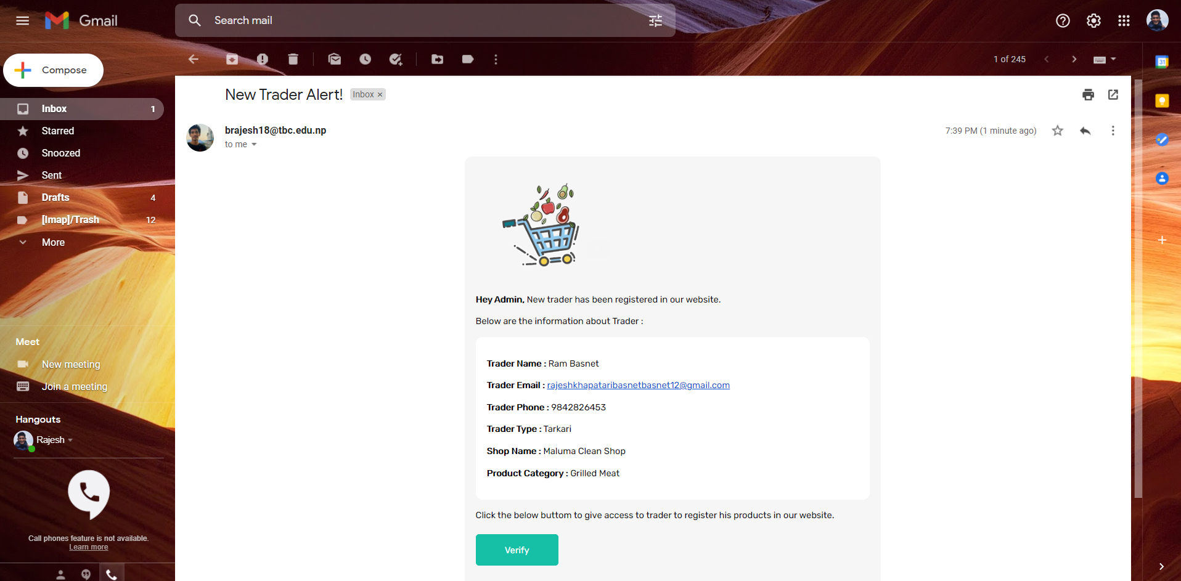
ADDITIONAL FEATURE (TRADER VERIFICATION)

Slide 28
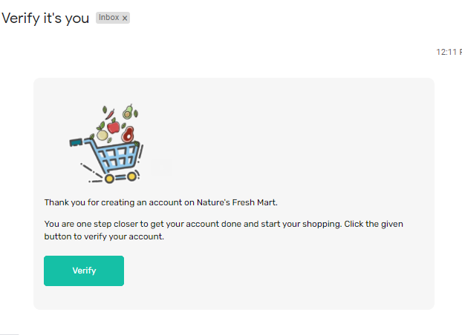
ADDITIONAL FEATURE (CUSTOMER VERIFICATION)

Slide 29
Now, we would like to proceed to the website demonstration with all the features included in our project.

